Slide 1
A manual to planning your United Way Campaign
United Way of Aroostook
Employee Campaign Manager
Guide

Slide 2
You’re an Employee Campaign Manager? That’s a really big deal!
Welcome to the United Way team! Your company or organization is passionate about making Aroostook County a better place to live, work and play. That’s why your workplace provides employees the opportunity to donate to causes that matter to them through United Way of Aroostook payroll deduction. Through collective generosity, we can all work together to continue to care for every generation by making a stronger, healthier community.
As an employee Campaign Manager (ECM), you’ll have a personal contact at United Way and an array of support materials to guide you each step of the way. And when your campaign is over, you can count on United Way as your year-round partner for volunteer opportunities, advocacy, and community involvement.
This handbook is your basic guide for how to prepare, plan, conduct and conclude your company’s campaign. We offer you many ideas, strategies, and resources to help make your campaign (whether it be virtual or in-person) a success. And remember, United Way staff and volunteers are here to help in any way we can. Our nonprofits have been there for us through thick and thin, it’s time to LEAD THE WAY for them!
With Appreciation,
United Way Executive Director Sarah Duncan

Slide 3
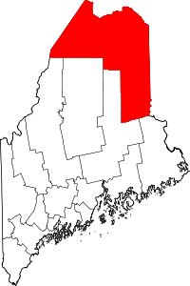
What is United Way?
United Way of Aroostook is a nonprofit organization serving all of Aroostook County. United Way funds more than 20 organizations and local programs to provide a better quality of life for people experiencing challenges and hardships.
HOW WE INVEST YOUR DOLLARS:
Basic Needs
Investments
Combating food insecurity, homelessness and other basic needs to help people escape poverty.
Health
Investments
Promoting health, healing and crisis intervention.
Education/Youth
Investments
Ensuring access to books that prepare children for learning. Protecting and bolstering our youth for long-term success.
Financial Stability
Investments
Creating pathways to financial stability so that every person has the opportunity to thrive financially.
YOUR GIFT
STAYS 100%
LOCAL!
ACROSS
AROOSTOOK
COUNTY
SUPPORTING
OVER
20
NONPROFIT
PROGRAMS
HELPING 1 IN EVERY 2 PEOPLE

Slide 4
TALKING POINTS
United Way supports local people. When you donate to United Way, you provide local folks with access to basic essentials, health care, education and financial stability.
A unique position to help. No other organization has the scope and expertise to unite and mobilize hundreds of human service agencies, businesses, government, volunteers and foundations around a common vision for the common good.
Create more long-term social change. Empower struggling communities to thrive while directing improving the lives of 1 in 2 Aroostook County residents.
Together, we can do more than any of us can alone. Through United Way, your contribution joins with those of others to have a more meaningful impact.

Slide 5
Campaign Checklist
PLAN
Attend ECM Training
Obtain and order campaign materials (virtual options available)
Visit www.unitedwayaroostook.org under campaigns for ideas and materials
Establish workplace campaign goals related to a dollar amount and participation percentage.
Recruit and train your committee: establish a timeline.
GEAR UP
Send a letter from management to employees (see example)
Review campaign supplies and prepare materials for distribution.
Schedule and plan a Kickoff Event (see example)
Contact United Way to request program speakers and/or virtual presentations.
CONDUCT
Build enthusiasm for the campaign through emails or video calls.
Distribute pledge forms and encourage 100 percent participation.
Send personal communications to all employees (see example)
Hold educational, socially distanced meetings and fundraising events with staff.
Send follow-up emails every few days to maintain enthusiasm.
Hold giveaways and drawings for those who have returned forms.
Follow-up with past contributors who have not yet responded.
CLOSE
Send a reminder email to submit outstanding pledge forms.
Collect forms. Make copies for your payroll/HR.
Announce your campaign results to co-workers. Thank all donors and the campaign committee.
Discuss implementation plan for the company’s new hires.
Choose Employee Campaign Manager for next year.

Slide 6
How can your staff
invest in
Aroostook County?
Individual Contribution
United Way makes it easy for you to donate through payroll deduction. However, there are many ways to invest in your community. For example donors can give monthly or one-time through credit card or electronic bank transfer (ACH).
Volunteer
Create lasting change
The community could always use extra hands – volunteer your time today!
Stay involved in the community after retirement through Always United or choose to name United Way as a beneficiary and support Aroostook County for generations to come.
Band together to create change
Join a network of community leaders advancing the common good through one of the following groups:
Emerging Leaders Society ($520-$699)
Leadership Circle ($700-$9,999)
Tocqueville Society ($10,000+)

Slide 7
Get Staff in the Spirit of Giving!
Possibly Virtual
Easy Fundraisers for Your ^ Campaign
IT’S TIME TO THINK OUTSIDE THE BOX
Lunchbox Auction
Employees create gourmet lunches to be auctioned off to the highest bidder. Give prizes for the most creative, nutritious and elegant meals.
Virtual Chopped Challenge
People pay to participate, film themselves receiving their set of ingredients and have to film their process of using the ingredients to make a finished product.
Virtual Office Bingo
Distribute printable Bingo Cards to employees who pay to play. Every day, email one bingo number to participants. The first one to reply with “BINGO” wins. The bingo game continues until all the prizes are distributed.
Coronavirus Swear Jar
Donation of $1-2 each time the virus is mentioned (outside of necessary mention).
Virtual Trivia
Send an email to invite employees to participate via email or posting on the company intranet. Inform them of any entry fee to participate and how they can pay. Create questions and answers and post to a digital platform – the first correct answer wins!
Guess the Number
Fill a clear jar with candy and have employees pay for a chance to guess the number of pieces in the jar. The most accurate guess wins the candy. This could also be done virtually by taking a photo and emailing it to participating employees.
Easy Raffles
Vacation Day
Raffle off a day or ½ day of vacation time.
VIP Parking
Raffle off prime parking spots for a time period.
GIFs Against Humanity
Send an email to everyone with a word or phrase and people have to respond with their best .gif or meme that summarizes that phrase. The winner will receive a gift card. Considerations: have an impartial umpire or judge for the games so that it is a fair contest for all.
Virtual Workout Class
Consider pairing the workout class with an overall health challenge - employees can pay $5 to enter the challenge and complete bingo with different health challenges (such as drinking water, walking a mile, etc.).

Slide 8
Here are a few things to keep in mind as your organization gears up to give!
Tips for a Successful Campaign
Time it right.
Choose a Campaign Kickoff time when you know your fellow employees will be most engaged.
Get high-level buy in.
When the CEO and senior managers are the first to give, others will follow their example.
Create a corporate match.
Connect corporate giving to employee giving by creating a corporate challenge match for staff gifts.
Promote. Publicize. Plan.
Raise awareness of United Way’s work. Send email updates. Form a committee. Count on UWA’s support.
Thank and celebrate.
Acknowledge those who help. Involve and recruit others who share your passion. Thank them again and again.
Let the spirit live on!
Opportunities to Lead the Way don’t end when your campaign does. Keep staff posted on UWA’s success!
Make it personal.
A personalized ask is best particularly from a friend. Utilize personal connections and communications.
Be visible.
Get on the agenda for scheduled company-wide Zoom calls or department meetings, or other gatherings.
Offer incentives.
Promote incentives, contests, or drawing to encourage giving.

Slide 9
FAQs for ECMs
How long should our campaign run?
For many companies, a two- or three-week campaign is the perfect amount of time to kick off your effort, get the message out effectively, and make your ask without over burdening staff.
When should our campaign take place?
Most campaigns take place between September and December, but they can happen at any time.
How can employees give?
Using a United Way pledge form, employees can give via payroll deduction, cash, check, credit card or ACH. Contributors can also set up an ongoing or one-time payment online at www.unitedwayaroostook.org.
Are there different levels of giving?
Yes. To join the Emerging Leaders Society, donors need to contribute at least $520. Leadership level giving starts at $700 per year.
When does payroll deduction typically start?
Payroll deduction typically runs from January 1 through December 31. Please let us know if another schedule works better for your company.
Are all donations to the United Way tax deductible?
Yes. All donors receive thank-you letters from United Way after the campaign has been completed. These letters can be used for tax deduction purposes to the full extent of the law.
Can employees designate their donations?
Yes. While checking “influence the condition of all” on your pledge form is the best way to help Lead the Way for our community, donors can designate their gift to individual 501(c)(3) nonprofit programs that benefit humans.

Slide 10
SAMPLE COMMUNICATIONS
Sharing United Way’s message just got easier.
These emails can be used as is or adjusted to fit your needs.
Please email sarah@unitedwayaroostook.org for an electronic, editable version of this page.
Email to Company Leadership
Subject Line:
For Your Consideration – United Way Annual Campaign Options
Dear [CEO NAME | COMPANY Leadership Team | HR Director | Etc.]:
Our company has always demonstrated through our contributions our belief that an investment in United Way is an investment in the community. Not only has (Company) distinguished itself as a leader in our field, but also as a leader in caring and giving to our community.
Again, this year we have an opportunity to lead by example by participating in the United Way of Aroostook’s Annual Campaign. By giving an annual personal gift through the campaign, you play a big role in helping address the increasing needs in our community. It also sends a clear message that you believe United Way is the best way to care for our community.
Please note that your decision to give to the campaign at any level is a personal one. Should you need additional information to make an informed decision, please do not hesitate to ask.
If you decide to participate, please complete, and return the forms provided to you to myself, our company’s Employee Campaign Coordinator. Thank you in advance for your consideration, and for helping (Company Name) Live United.
Sincerely,

Slide 11
Email to Workplace Employees
Subject Line: Kicking Off Our United Way Annual Campaign
Dear Employee,
Please mark (Date) on your calendar as the kick-off for (Company’s) Annual United Way of Aroostook fund-raising effort. This year’s campaign will run from (Date to Date) and our Campaign Coordinator (Name), has put together a series of exciting events for us to participate in and support.
(Company Name) cares deeply about our community and the equality of life that makes the Aroostook County area unique. And United Way of Aroostook focuses resources to provide solutions for our community’s most pressing problems.
Through our contributions, we can make sure help is there for families, co-workers, and friends. United Way of Aroostook assures that a broad range of services is available to help local people become independent and self-sufficient. I believe that supporting United Way of Aroostook is a sound decision. We will have a chance to learn more about United Way of Aroostook during our upcoming kickoff rally.
(Company Name) is proud to support United Way of Aroostook. See you all at the kickoff.
Sincerely,
[NAME]
[COMPANY]’s United Way Employee Campaign Coordinator

Slide 12
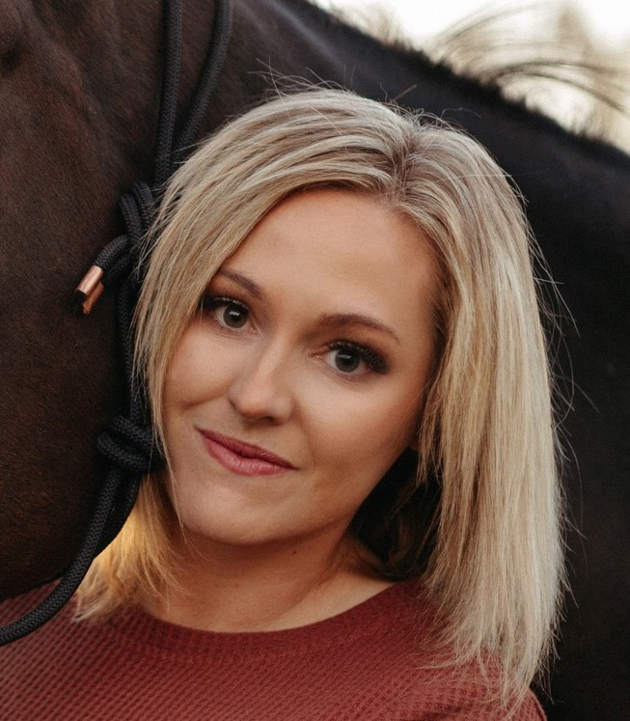
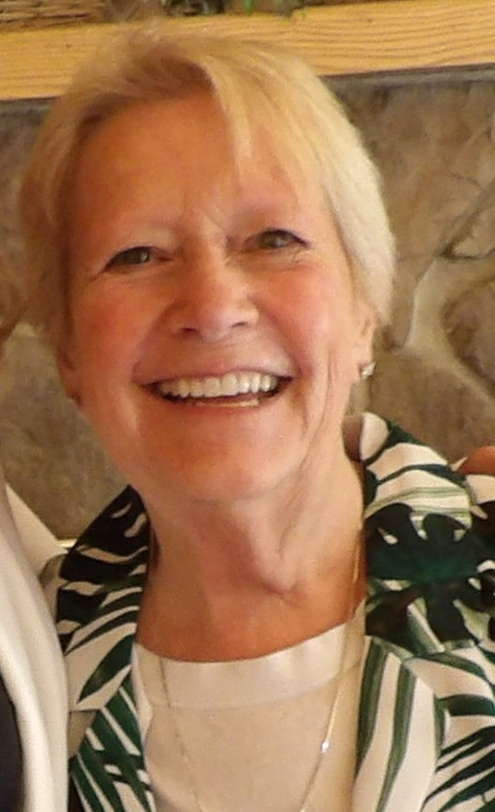
MEET THE TEAM
Your United Way representatives are here to help, every step of the way.
Sarah Duncan
Executive Director
sarah@unitedwayaroostook.org
Sue Watson
Finance Administrator/Volunteer Coordinator
sue@unitedwayaroostook.org

